Slide 1
JAVA SEMINAR
11. Write a Java Message Service program to implement a simple client server application using point to point messaging domain.

Slide 2
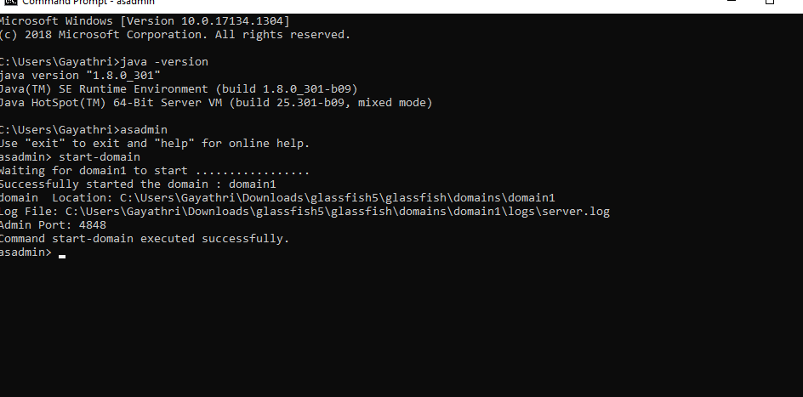
STEP 1:
INSTALL glassfish application server and add it to netbeans IDE

Slide 3
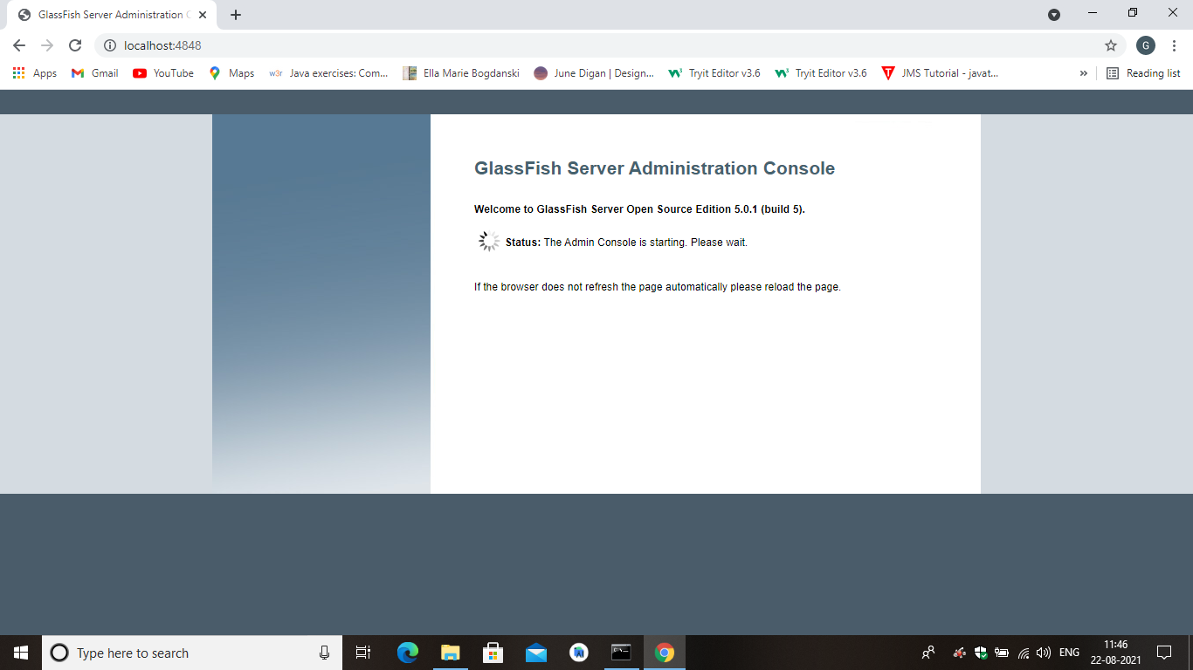
Step 2:
GLASSFISH server gets started.

Slide 4
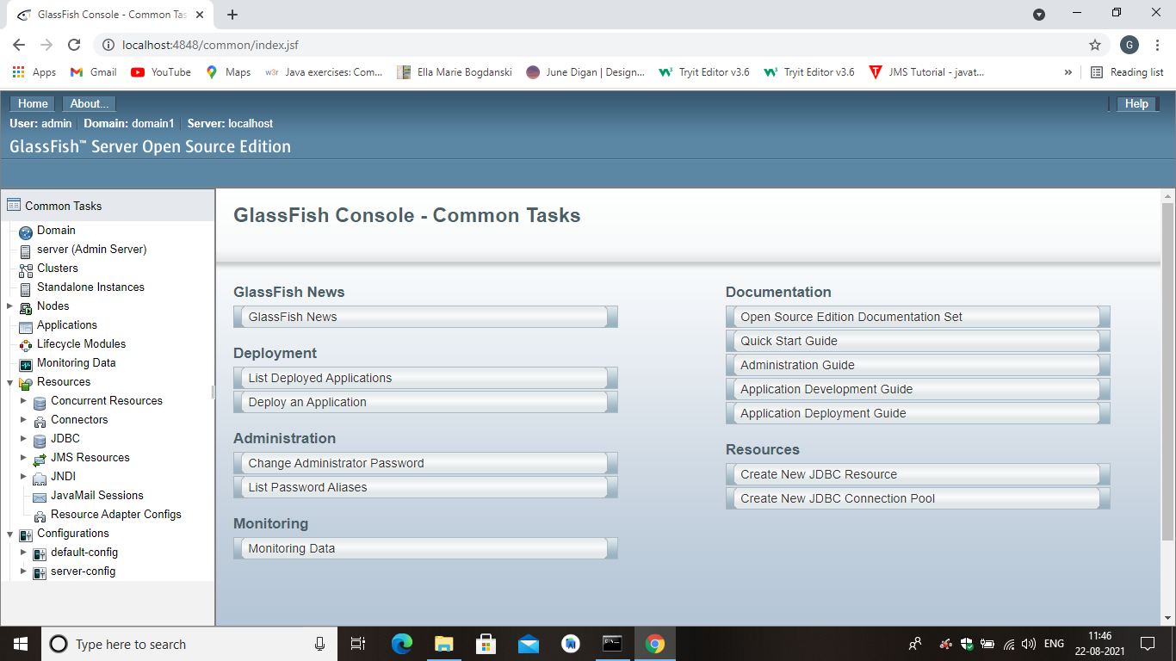
STEP 3:
GLASSFISH console.

Slide 5
STEP 4:
CREATE new project as enterprise application .
And create message driven class “MYLISTENER.JAVA”
Java class as “MYSENDER.JAVA”
One default HTML file “INDEX.HTML”.

Slide 6
STEP 5:
Create two JNDI
Create connection factory named myQueueConnectionFactory.
Create destination resource named myQueue
After creating JNDI, create the mentioned files.

Slide 7
STEP 6:
DEPLOY the project.
After successfull build.
In glassfish console , launch the project.

Slide 8
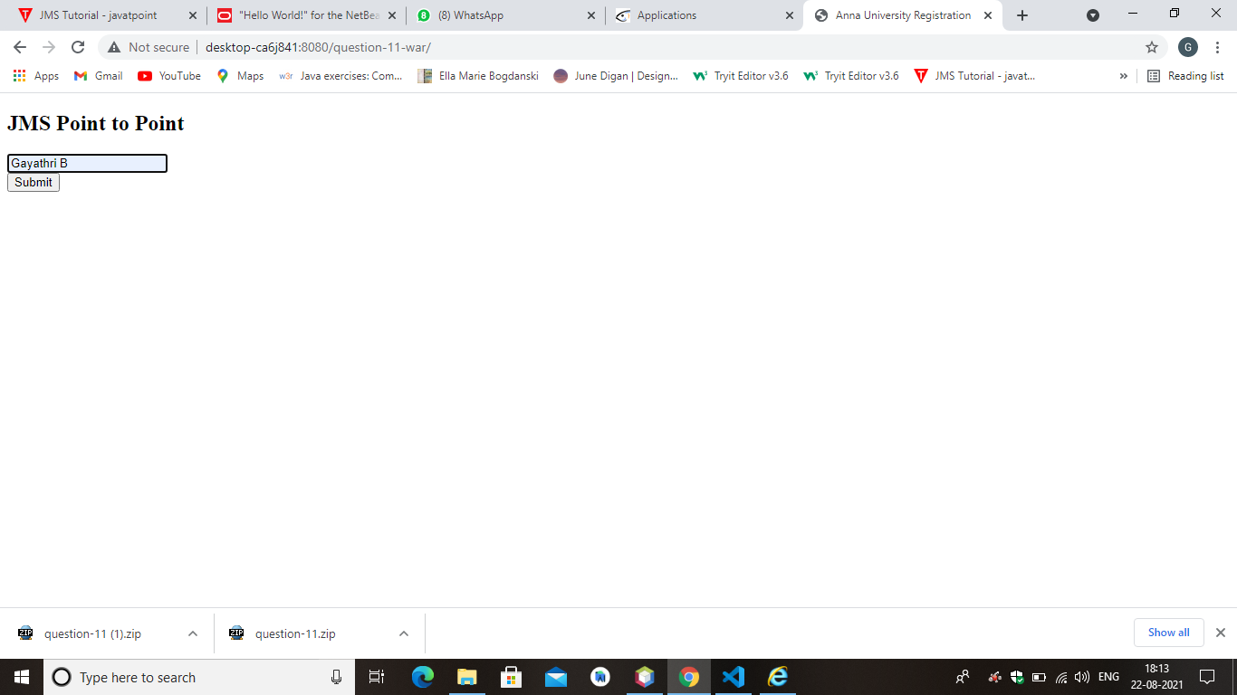
STEP 7:
OUTPUT

Slide 9
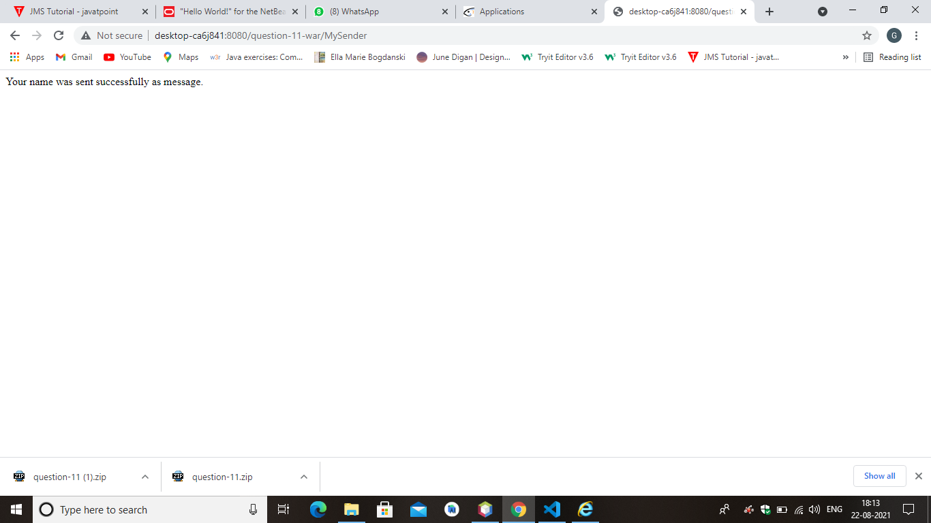
STEP 8:
AFTER SUBMITING

Slide 10
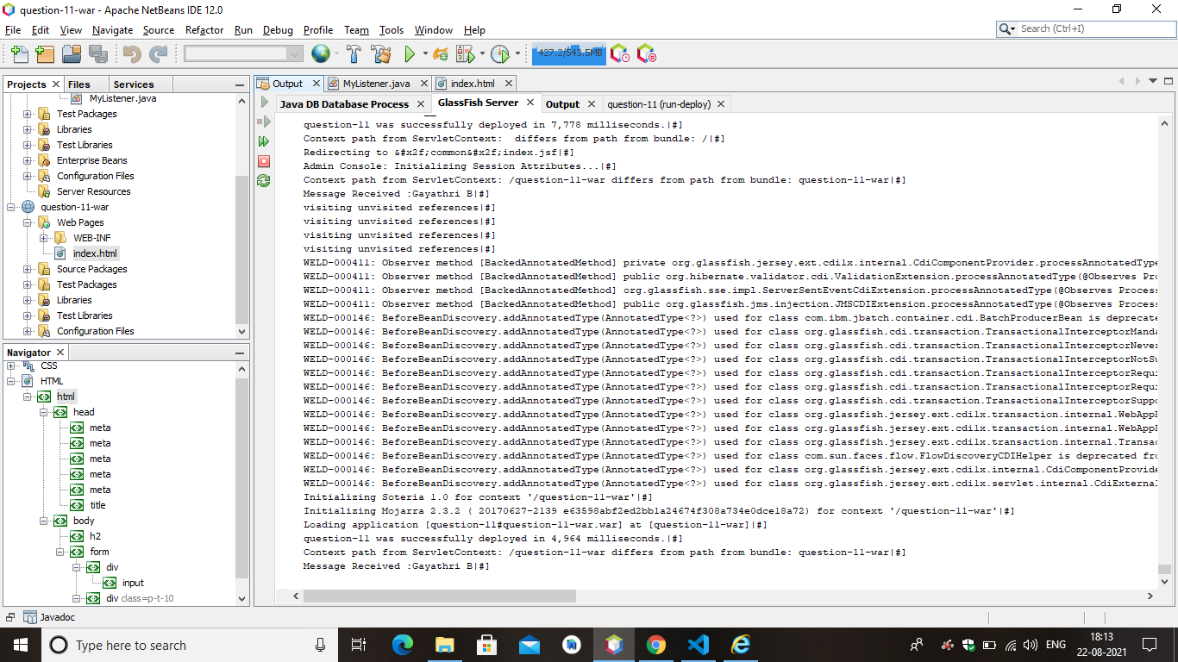
STEP 9:
IN CONSOLE

